Slide 1
Optical Networks
Module 4

Slide 2
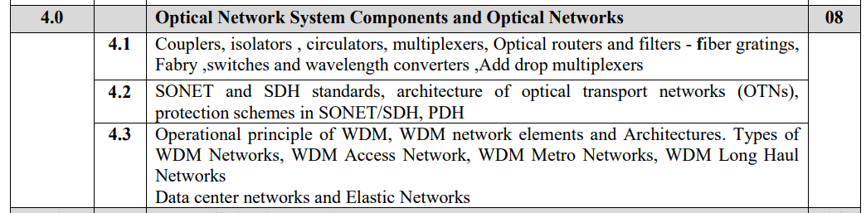

Slide 3
Layer of optical networks:

Slide 5
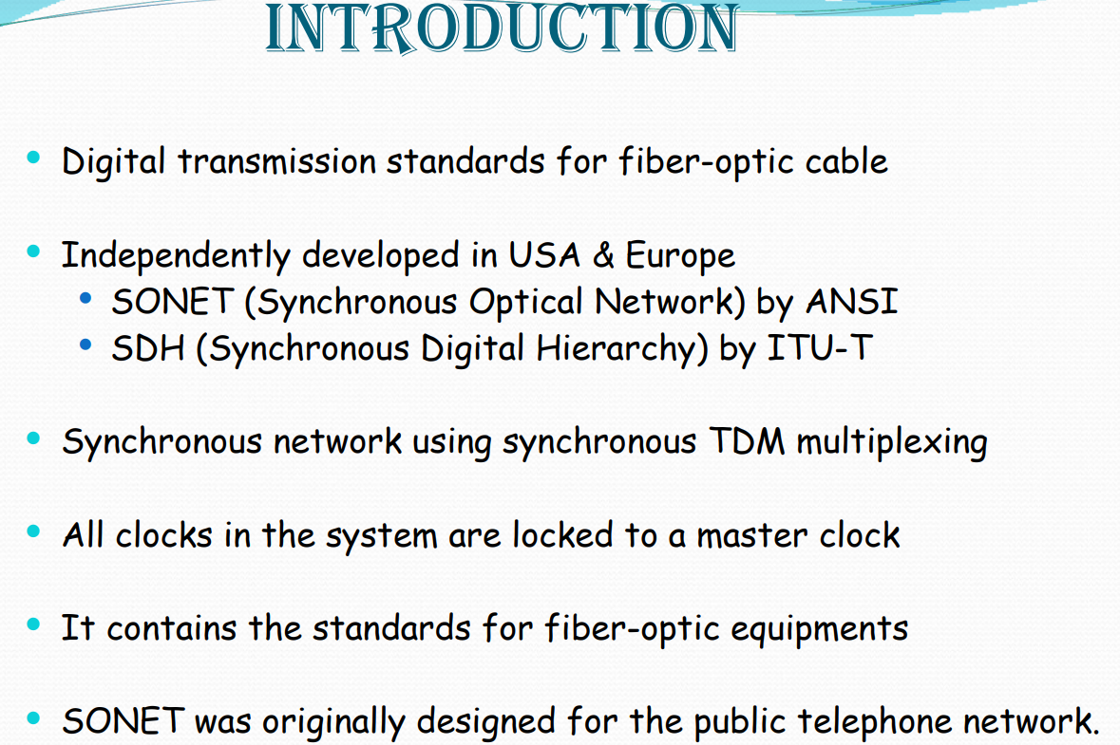
ANSI: American National Standards Institute
ITU-T: International Telecommunication Union – Telecommunication Standardization Sector
Frame size i.e the bigger level abstraction is same for both

Slide 6
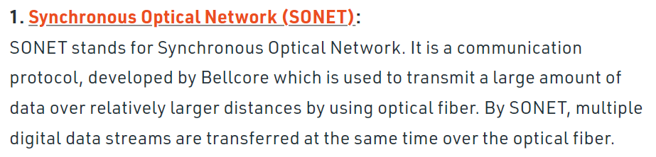
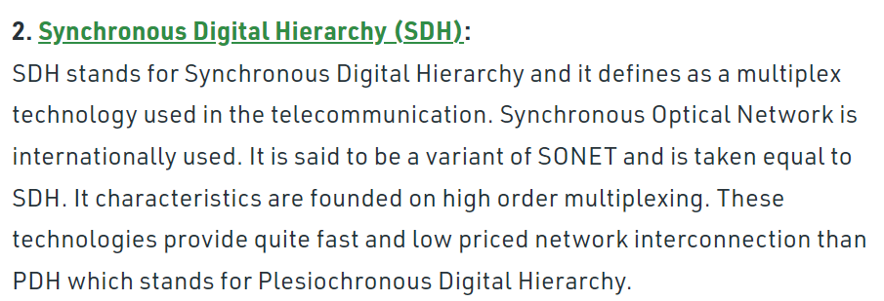

Slide 8
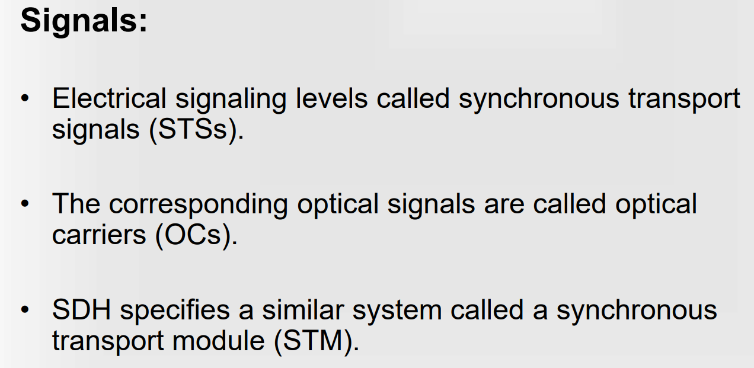

Slide 9
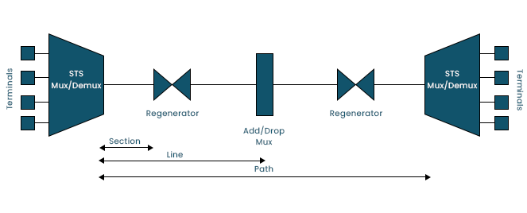

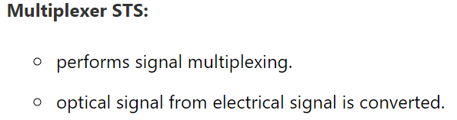

Elements of SONET:

Slide 10
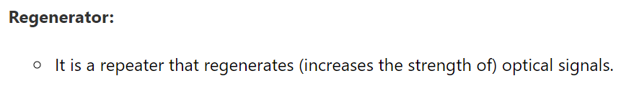

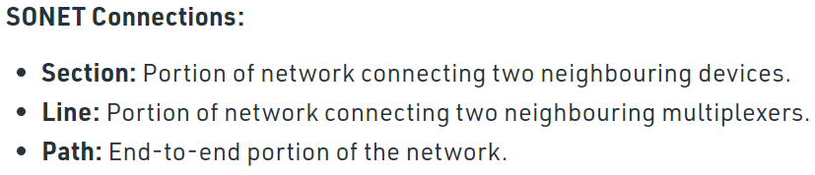
Why is SONET Used?
SONET is a technology that converts electrical signals into optical signals, allowing them to travel across larger distances.

Slide 11
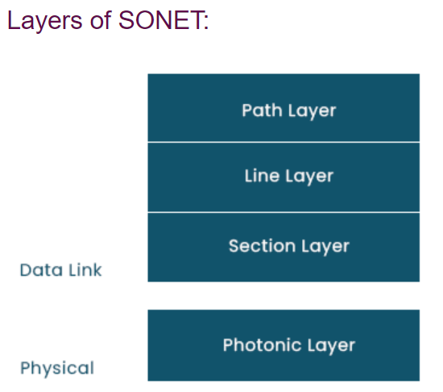
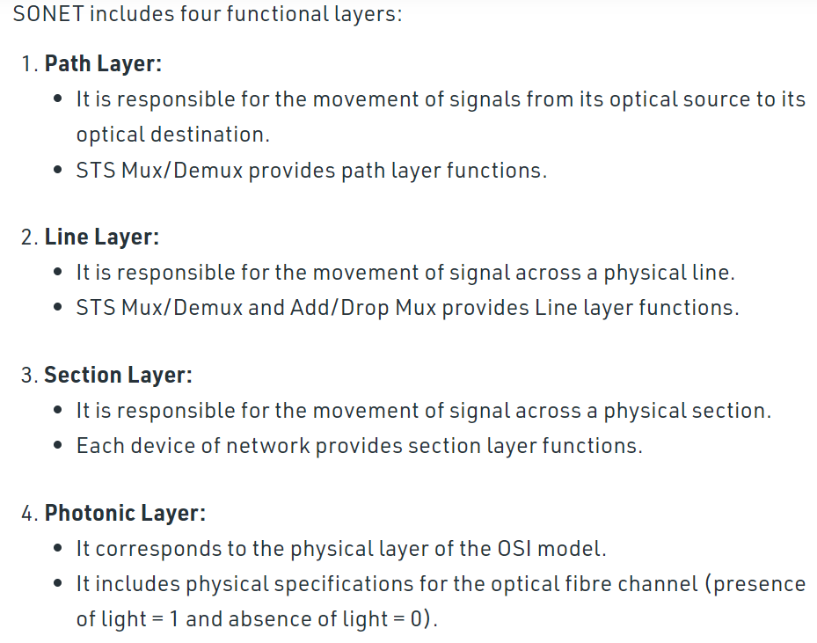

Slide 12
Transmission Formats and speeds
Commonly Used SONET and SDH Transmission Rates

Slide 13
Payload rate
= 87 cols * 9 rows * 8 bits * 8000 frames
= 50.112 Mbps

Slide 14
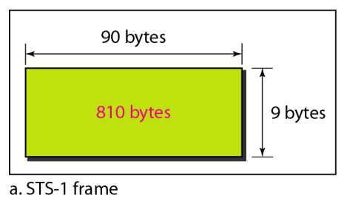
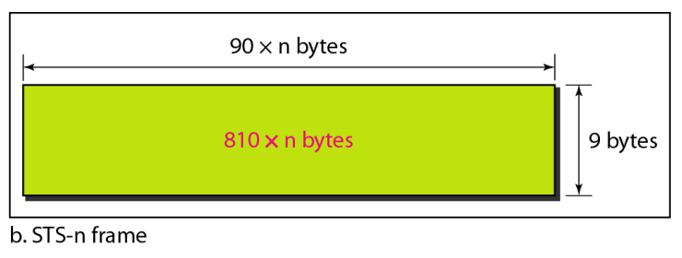

Slide 15
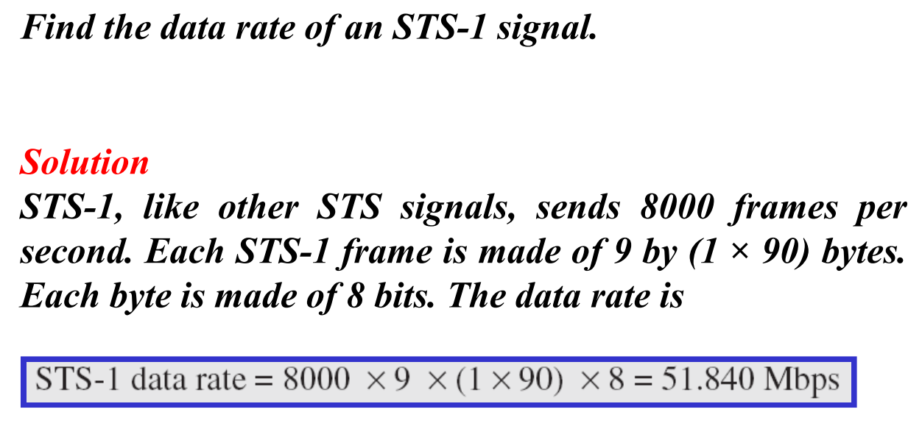

Slide 16
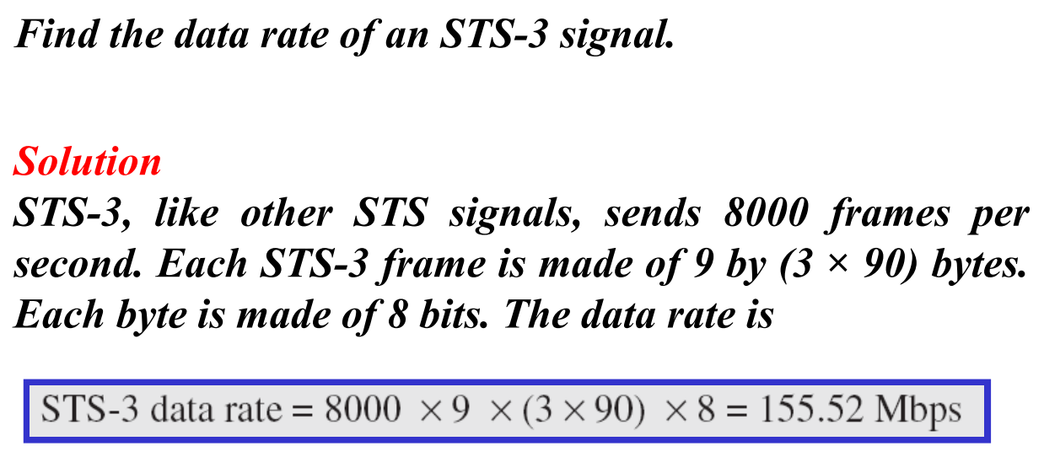
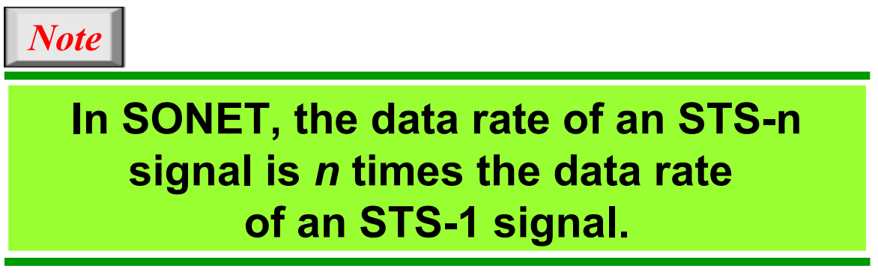

Slide 17
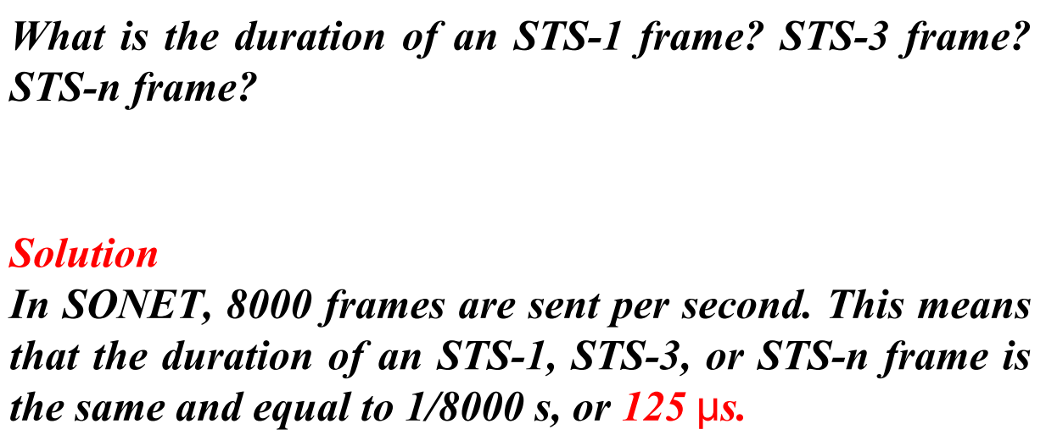


Slide 18
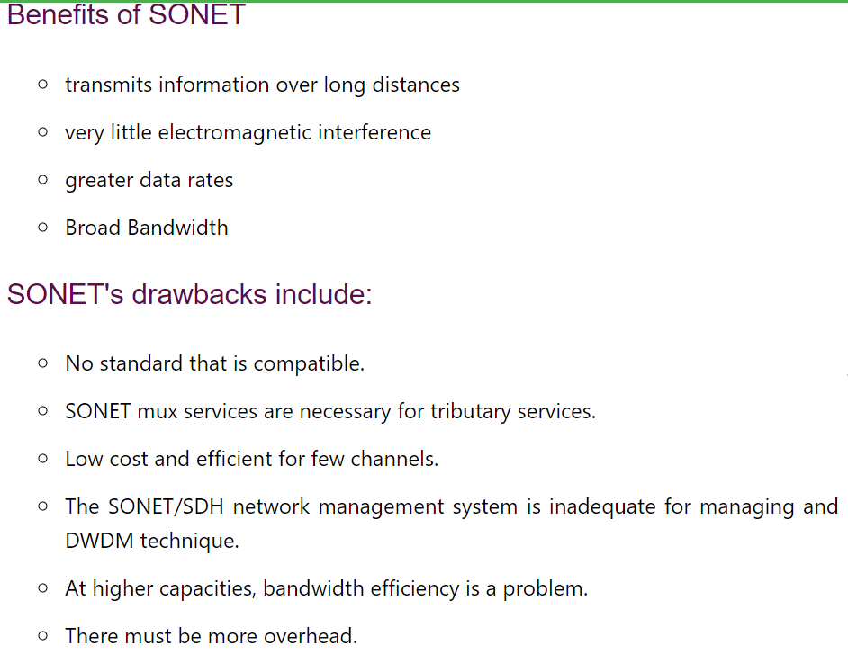

Slide 19
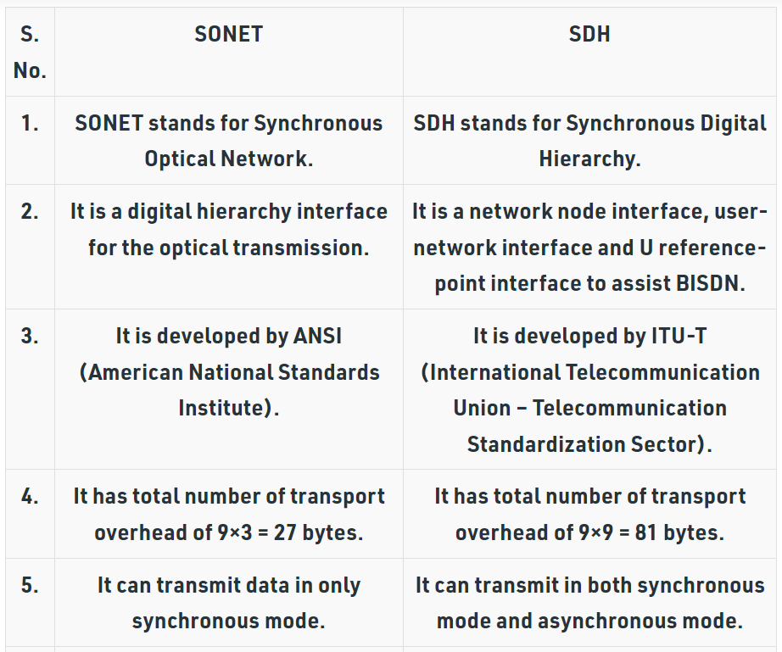

Slide 20
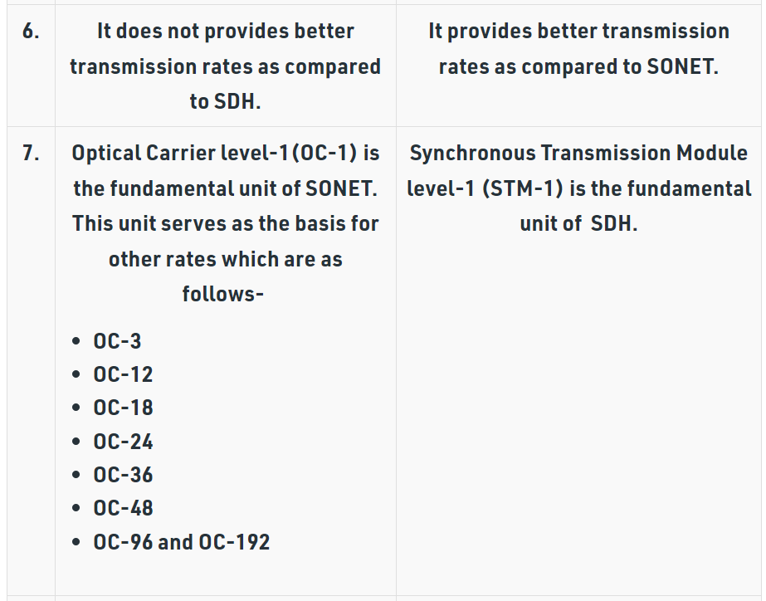

Slide 21
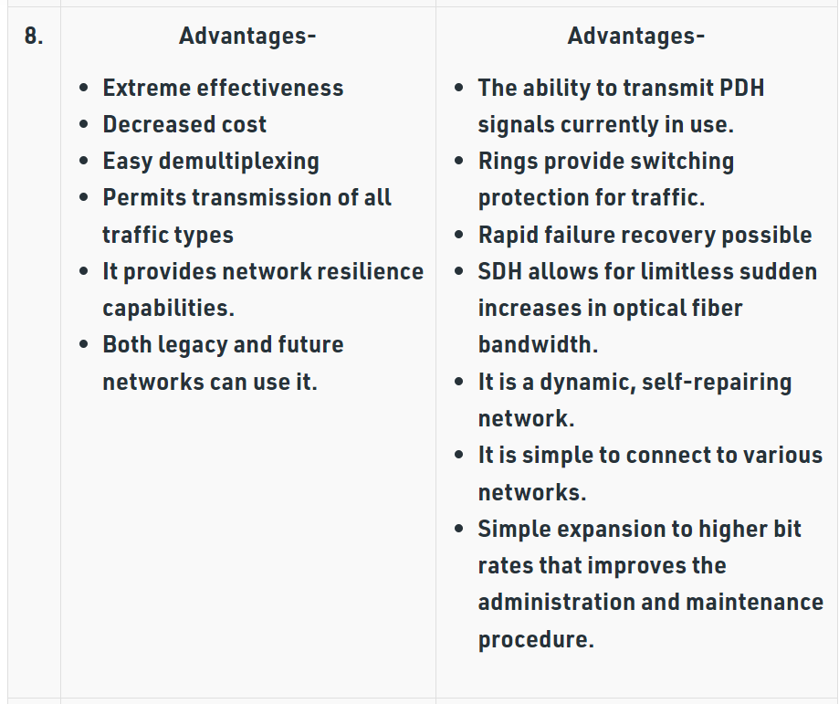

Slide 22
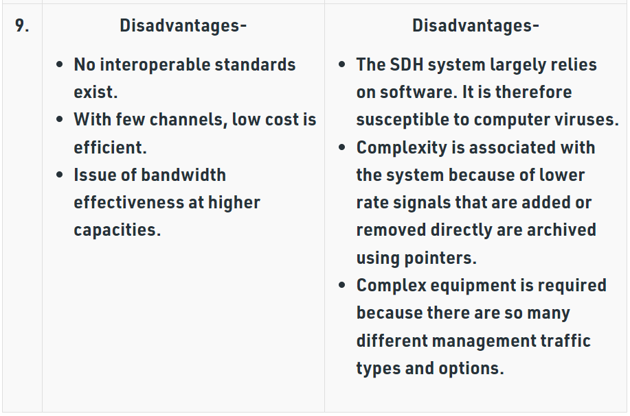

Slide 23
Railtel is a neutral telecom infrastructure provider in the country owning a Pan-India optic fiber network on exclusive Right of Way along the Railway track.

Slide 26
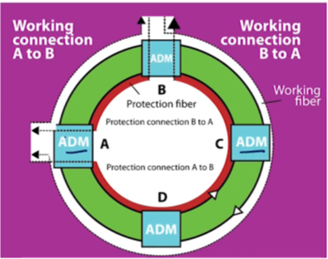

Slide 28
